Slide 1
Veterinarians
are
Microorganism
Detectives

Slide 2
Today – you are the Vet…
Loki has a nasty cough!
You must use your detective skills to work out what is making him sick…

Slide 3
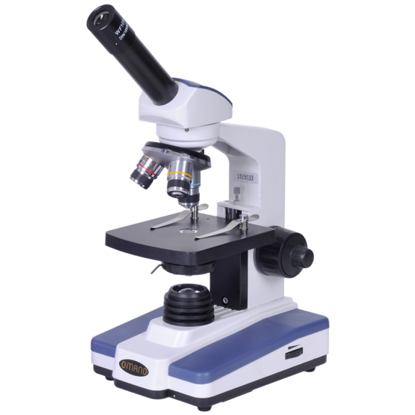
What is micro? µm
Who are the suspects making Loki sick?
Hairballs?
Asthma?
Cancer?
Or- an infection with a microorganism?
How will you work it out?
What questions will you ask?
1000mm = 1m
1000µm = 1mm
That’s really small!

Slide 4
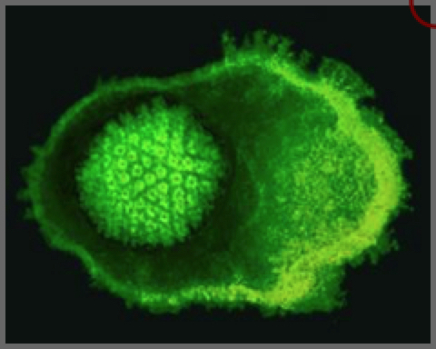
Suspect Microbe No. 1 : The Virus
Really, really small – electron microscope
Can only grow and multiply inside living cells
Vaccinations exist for some viral diseases
Feline Herpes Virus
Size: 1/10 of a micrometer

Slide 5
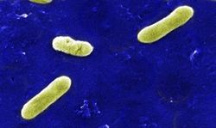
Suspect Microbe No. 2 The Bacteria
Single cells, no nucleus
They are everywhere, and sometimes cause disease
Bordatella bronchiseptica
8/10 micrometer long

Slide 6
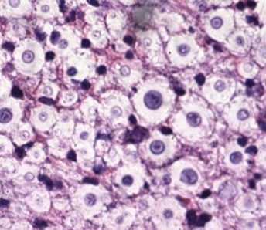
Suspect Microbe No. 3 The Fungus
Fungi include single-celled organisms and also mushrooms!
Have cell walls and nucleus
There are over 2 million different fungi
Cryptococcus neoformans
5-10 micrometers in diameter

Slide 7
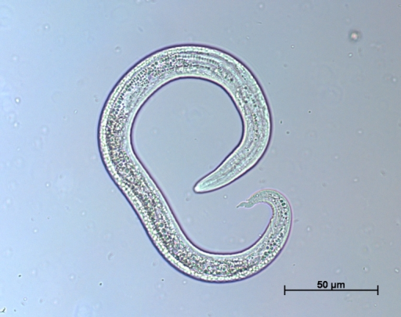
Suspect Microbes No. 4 Parasites
Protozoa – one cell - tummy and blood
Worms
eggs, larvae and adults
Have many body systems – complex
Cat lungworm larvae
Aelurostrongylus abstrusus
300 micrometers long, kinked tail

Slide 8
Now – a word from our sponsors
https://www.youtube.com/watch?v=24IYt5Z3eC4

Slide 9
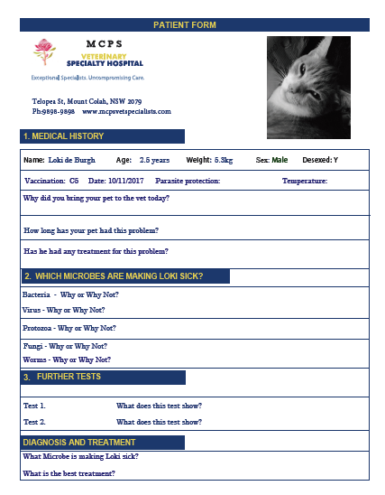
Let’s check out Loki
Good detectives keep records – fill in your patient history…
Detectives need to use all of their senses
Ask lots of questions
Do a vet check – temp. HR, physical examination

Slide 10
What’s next??

Slide 11
Test 1. How can we look on the inside?

Slide 12
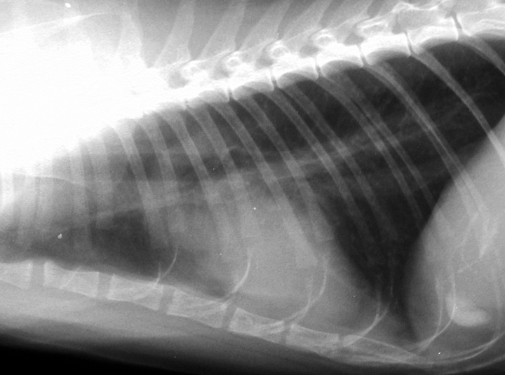
What’s different?
Normal cat chest x-ray Loki chest x-ray
Lung disease – less air, inflammation and pus - YUK

Slide 13
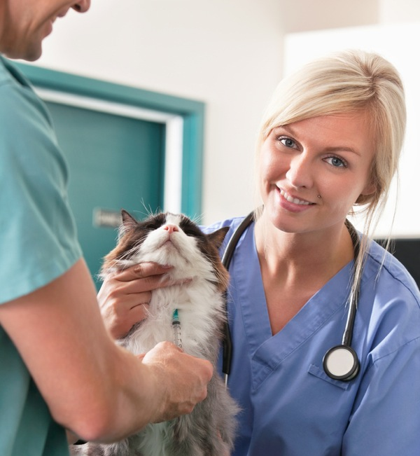
What test can we do next?
Blood test

Slide 14
Eosinophils
Viral PCR: Feline Herpes Virus: negative
Fungal PCR: Cryptococcus: negative

Slide 15
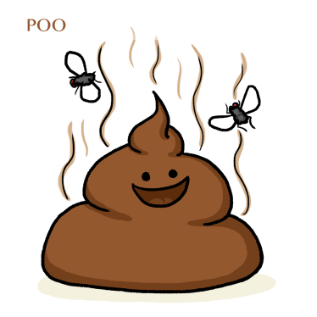
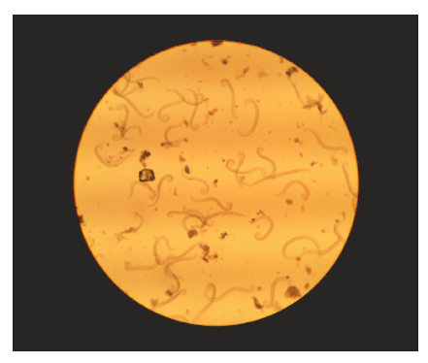
And – one last test…

Slide 16
What’s your diagnosis?
Bacteria ?– Loki had two lots of antibiotics and it didn’t help
Virus ? – blood test was negative
Fungus ? – blood test was negative
Lungworm – larvae seen from poo sample
Aelurostrongylus abstrusis
Well done Microbe Detectives!
Treatment – which medicine?

Slide 18
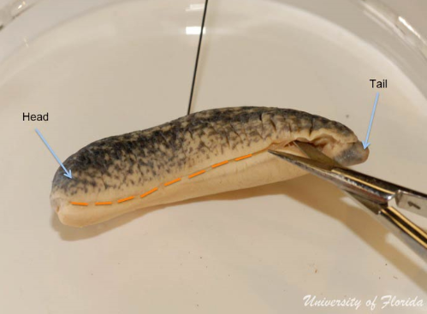
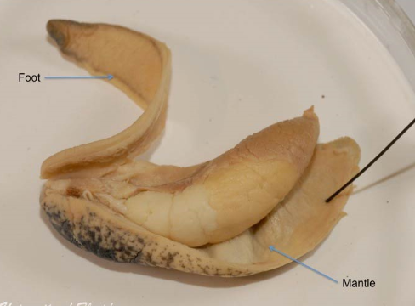
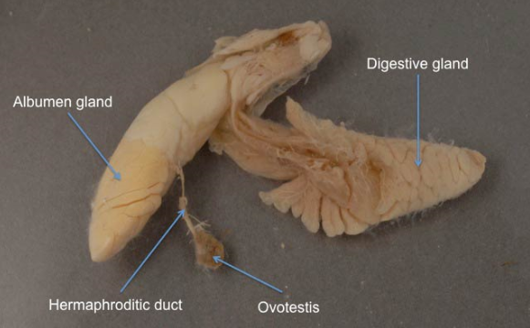
Let’s have a look inside a slug! See if we can find any lungworm larvae

Slide 19
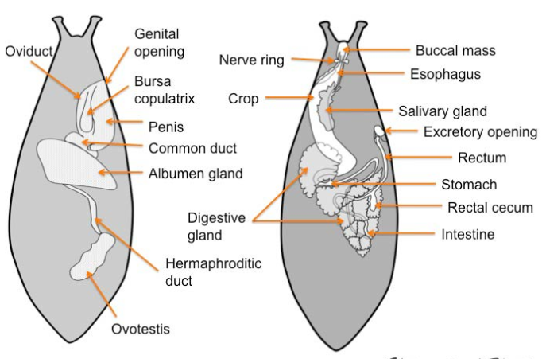
Draw a picture of your slug in your science book,
and don’t forget to glue in your patient history sheet!

